Slide 1
Progress Presentation
Remote Lung Auscultation Device
Hannah Aaron, Loren Shin & Kevin Xie

Slide 2
Updated Need Statement
Given the current lack of personal-use instrumentation for remotely monitoring and classifying lung sounds, it is imperative to develop an affordable, digital, and self-operable lung sound recording and classifying -- as normal, crackling, or wheezing -- device, in both real-time and previously recorded sounds, for doctors and nurses to closely monitor the pulmonary activity of patients with a chronic lung disease.

Slide 3
Update Project Scope
Evidently, there is a need, by physicians and nurses working in telemedicine, for a digital, affordable and patient-friendly device that is capable of recording and classifying lung sounds so that they may remotely monitor the pulmonary activity of their patients. By the end of April, we propose to have a working prototype of this device -- with the ability to capture and classify lung sounds -- along with the necessary software code and device design schematics. This prototype will need to be self operated and able to filter out unwanted sounds (i.e. heart sounds). The software code should be able to classify sounds as normal or abnormal (i.e. wheezing or crackling). The prototype will follow the updated design specifications.

Slide 4
Changes and Additions to Design Specifications
General Specifications
Total Maximum Volume: 2,000 cm³
Duration used by Patient: 5 - 10 mins/day
Hardware - Sound Recording Platform Specifications
Computer Connection Interface: Bluetooth
Dimensions: 5 cm diameter
Sampling Location: 10 areas
Accuracy of placement: Within 6 cm
Component weight: 0.5 lb
Power Source: Internal Power
Hardware - Device Body Specifications
Dimensions: Radial distance of 30 cm
Component Weight: 2lb
Software Specifications
Accuracy: greater than 80%
Classification Domains: Normal, Wheezing, Crackling

Slide 5
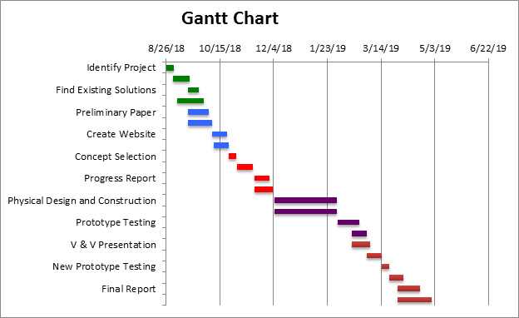
Design Schedule

Slide 6
Team Responsibilities
 | Loren | Hannah | Kevin
Research | x | x | x
Mentor Outreach |  |  | x
Website | x | x
Brainstorming | x | x | x
CAD Modeling |  | x
Software Coding | x |  | x
Prototyping | x | x | x
Prototype Testing | x | x | x
Preliminary Presentation |  |  | x
Progress Presentations | x
V & V Presentation |  | x

Slide 7
Design Alternatives

Slide 8
Hardware Design Solutions - Single Location Recording
Trigger Point Cane with a Single Stethoscope Head
Vest with Singular Stethoscope Heads
Strap with a Horizontally Sliding Head
Suspenders with Vertically Sliding Heads
Velcro Band
Neck Strap / Attachment
Notes:
-Eko Core Attachment
-Smalller area covered

Slide 9
Hardware Design Solutions - Multi-Location Recording
Trigger Point Cane with a Multi-Stethoscope Giant Head
Vest with Scattered Stethoscope Heads + Microphones
Wall-Mounted Pad
Chair-Draped Pad
BackPad
Reverse Bib Pad
Notes:
-Microphone-based sound capture
-Larger area covered

Slide 10
Locations for Auscultation
Notes:
-Posterior (back) side is more important to listen to, but should be able to auscultate on both the anterior and posterior

Slide 11
Trigger Point Cane
Notes:
-The trigger point cane will allow for a wide range of auscultation locations while being able to limit the range of motion for the user
-swivel head

Slide 12
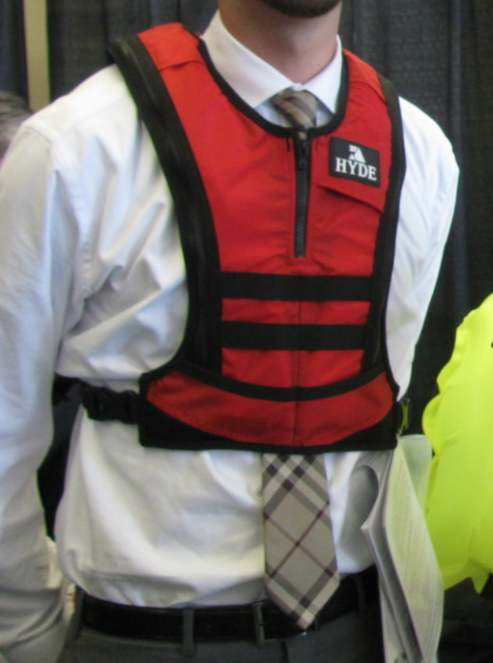
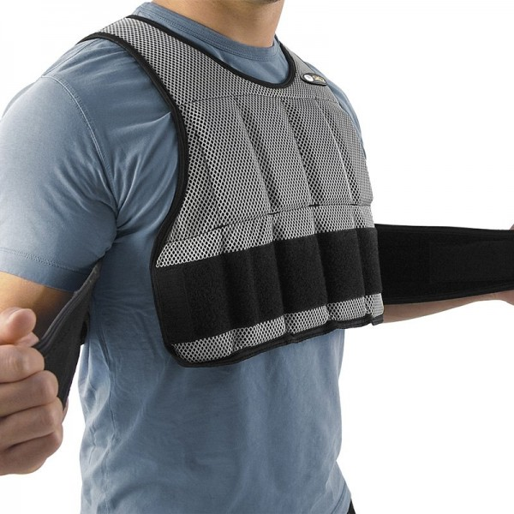
Vest
Notes:
This is an image of the kind of vest that would be used in an auscultation device. Stethoscopes or microphones would be placed on both the front and rear faces of the vest, which would be put on by pulling over the user’s head.

Slide 13
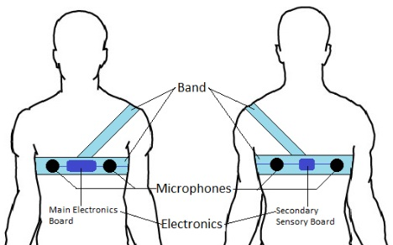
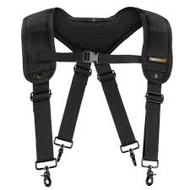
Strap & Suspender
Notes:
-The strap would look similar to the image shown on the left, without the auxiliary strap around the user’s shoulder and using stethoscopes instead of microphones.
-The suspenders would look something like the image on the right, in which the stethoscope heads would vertically.

Slide 14
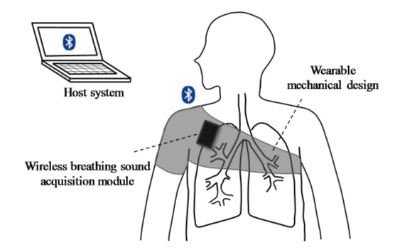
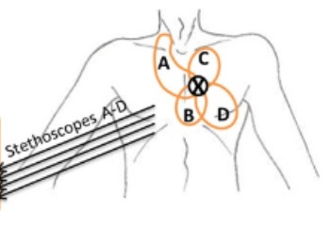
Chest Band & Neck Attachment
Notes:
-The image on the left shows a chest band in which a stethoscope would be placed such that it would be movable horizontally along the strap around the circumference of the patient’s torso.
-The image on the right shows the locations in which a neck attachment would capture lung sounds. A stethoscope would be attached to a strap worn around the user’s neck and would be able to reach these four zones to pick up sound.

Slide 15
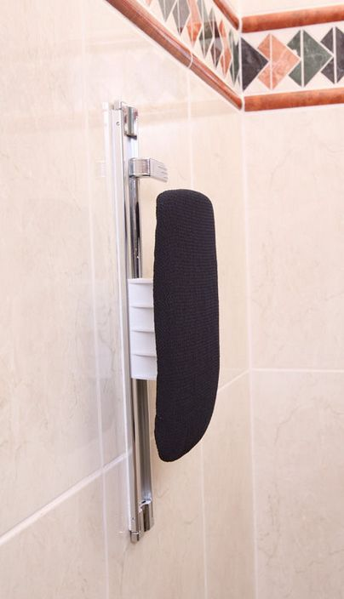
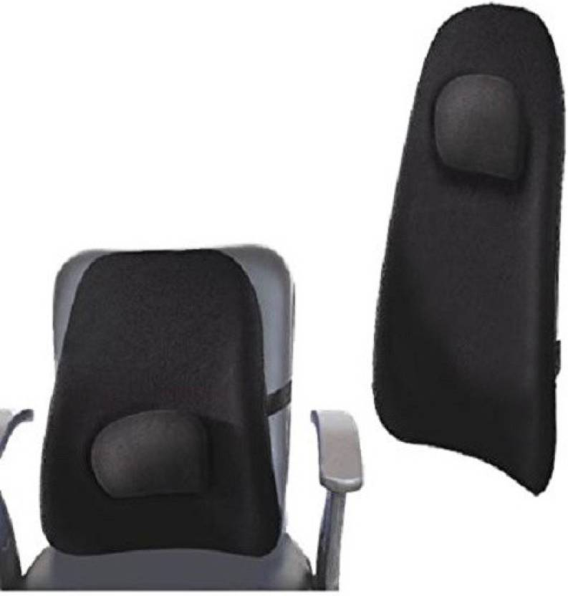
Wall- / Chair- Mounted Pad

Slide 16
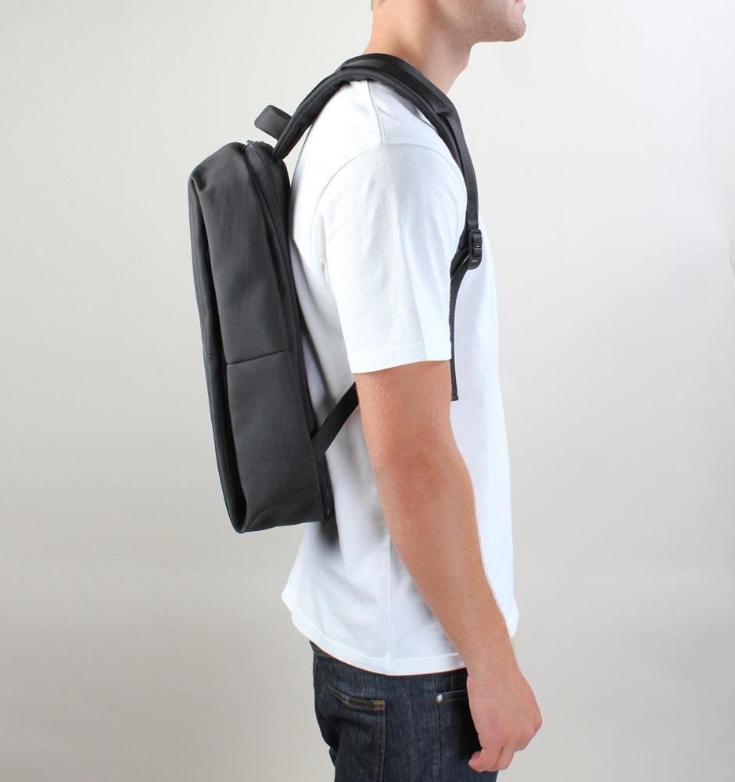
BackPad

Slide 17
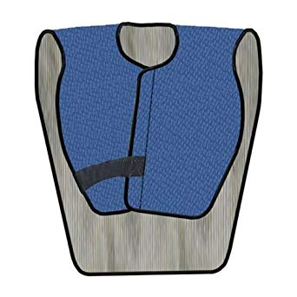
Reverse Bib Pad

Slide 18
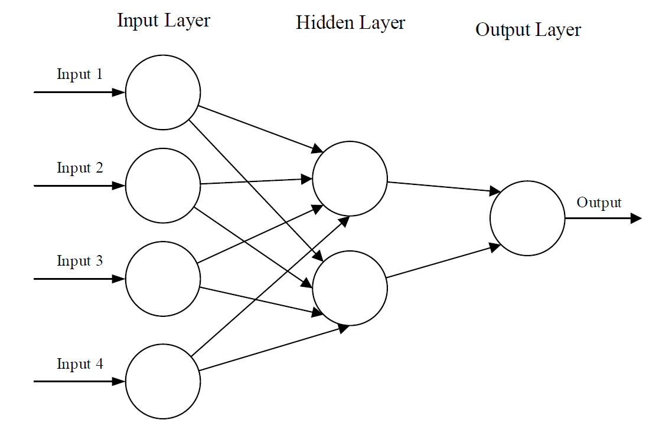
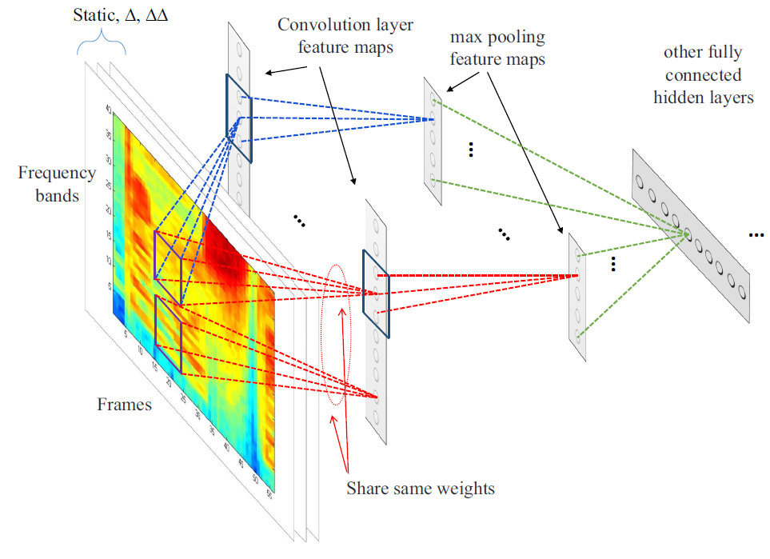
Software Solutions: Neural Networks
Artificial Neural Networks (ANN)
Information passes through layers of weights
Convolutional Neural Networks (CNN)
Convolutional and pooling layers on top of ANN hidden layers
Applies convolution and dimensionality reduction
Graphical representation of an artificial neural network. Taken from [33]
Representation of CNN, showing convolution, pooling and hidden layers. Taken from [1].
Notes:
Generally, neural networks are very computationally expensive and very slow. However, they can be incredibly powerful, versatile and applicable in many situations.

Slide 19
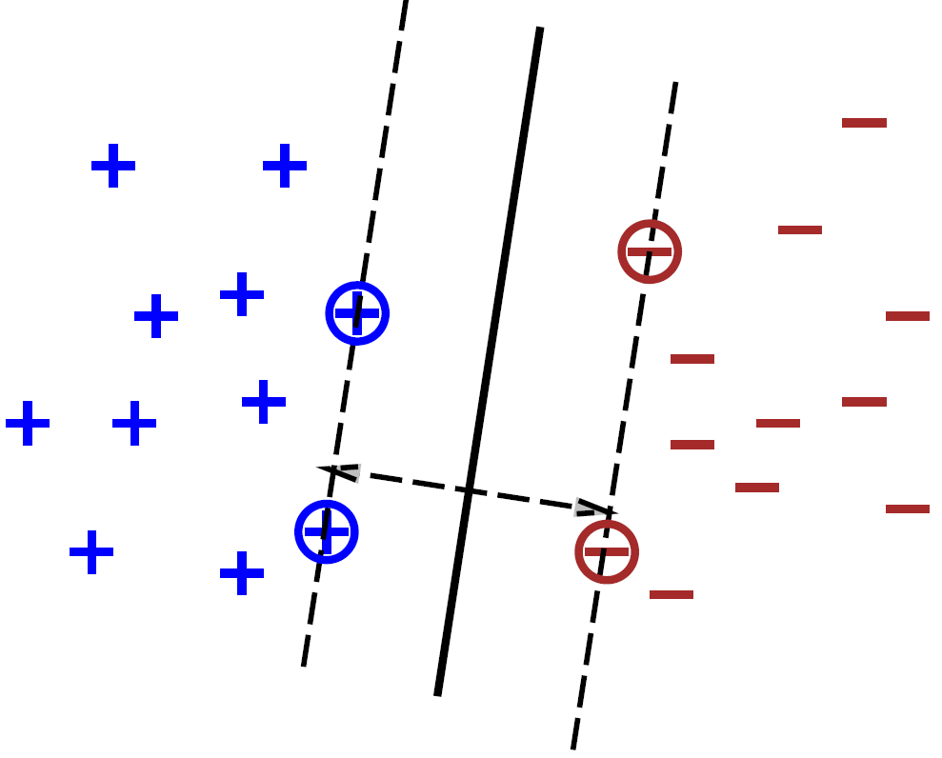
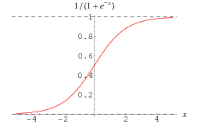
Software Solutions: Linear Algorithms
Logistic regression (LR)
Applies weights to data
Feed results through logistic function
Returns prediction probabilities
Support Vector Machines (SVM)
Maximizes margins between classes and hyperplane
The logistic or Sigmoid Function. Taken from [34]
A support vector machine separating "+" from "-". The dotted lines represent the maximal margin, while the solid line represents the separating hyperplane. The circled points are the support vectors. Taken from [6]
Notes:
Linear algorithms are fast and have the potential to be powerful (especially SVMs). However, they are limited in this situation by having only binary output.

Slide 20
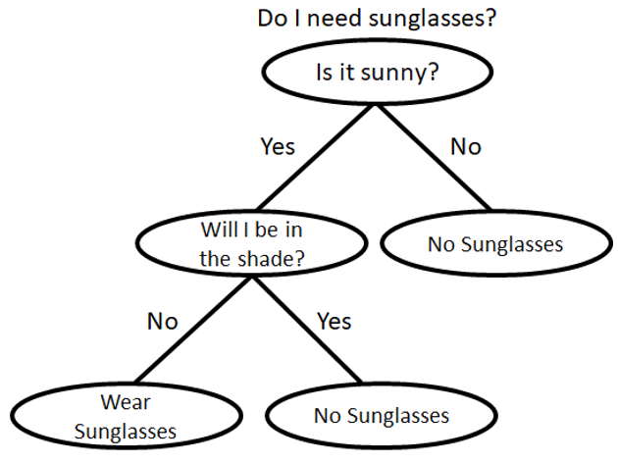
Software Solutions: Decision Tree Algorithms
Random Forests (RF)
Aggregation of full trees trained simultaneously
Adaboost
Aggregation of short trees trained sequentially
Each tree learns from errors of predecessor
A decision tree to determine if one should wear sunglasses.
Notes:
Generally, Decision tree algorithms are simple, relatively fast and can be accurate.

Slide 21
Software Solutions: Nearest Neighbor Algorithms
Assumption: f (x) ≈ f (x+h) for small h
Nearest Neighbor (NN): Use nearest known point to classify new point
K-Nearest Neighbor (K-NN): Use K nearest known points to classify new point
Notes:
Nearest neighbor algorithms are simple, easy to implement, and fast. Unfortunately, they must carry around all of the data they come across and are therefore memorically expensive

Slide 22
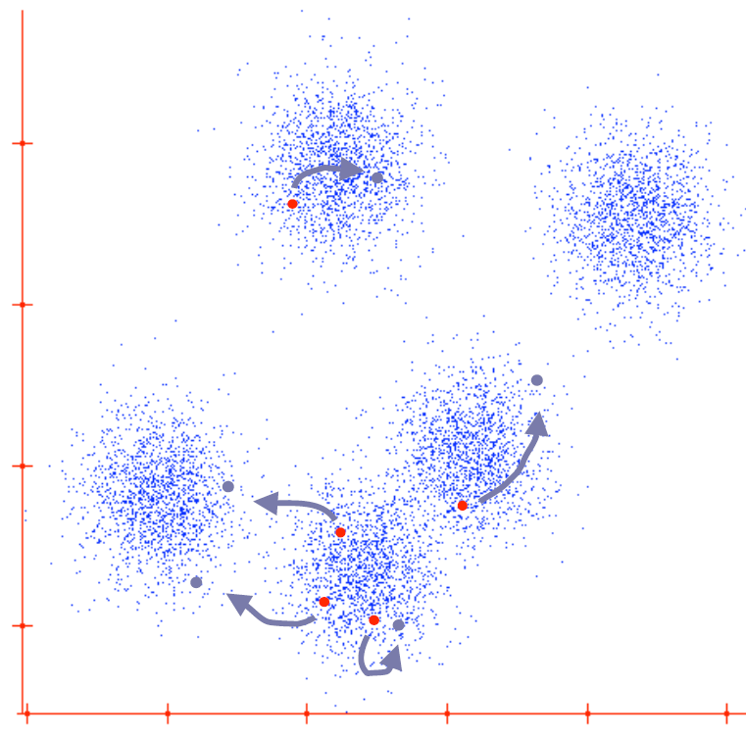
Software Solutions: Clustering Algorithms
K-Means Clustering (K-M)
Iteratively improves cluster centers using the mean of the points closest to center
Gaussian Mixture Model (GMM)
Fits data using gaussian distributions with mixing
A single intermediate iteration of the K-means clustering algorithm. The red points indicate the original cluster centers, while the blue-gray arrows and points indicate the direction of travel and new cluster centers, respectively. Taken from [35]
A trained GMM showing 3 clusters. Taken from [36]
Notes:
Generally, clustering algorithms can be fast and scale well with increasing amounts of data. They perform moderately well in many scenarios.

Slide 23
Analysis of Solutions

Slide 24
Analysis of Hardware Solutions: 8 Critical Factors
Mobility: How easy is it to move the device to another location on the body?
Sound Quality
Comfort
Ease of Use
Accuracy of Auscultation Location
Cost
Adjustability: Can the device’s dimensions be adjusted to fit different users?
Device Storage

Slide 25
Pugh Chart: Hardware Solution

Slide 26
Specifications |  | Trigger Cane w/ Single Head | Trigger Cane w/ Multi Mics | Vest w/ Stetho. | Vest w/ Mics. | Strap | Suspenders | Velcro Band | Neck Strap / Attachment | Wall - Mounted Pad | Chair - Mounted Pad | BackPad | Reverse Bib Pad
Parameter | Wgt
Mobility | 8 | 8 | 8 | 2 | 2 | 8 | 5 | 3 | 2 | 2 | 2 | 1 | 3
Sound Quality | 10 | 10 | 4 | 8 | 4 | 9 | 9 | 9 | 6 | 4 | 4 | 4 | 4
Comfort | 5 | 5 | 5 | 5 | 5 | 3 | 3 | 4 | 3 | 4 | 5 | 4 | 4
Easy of Use | 7 | 7 | 7 | 3 | 3 | 5 | 5 | 6 | 6 | 6 | 6 | 5 | 6
Accuracy of Auscultation Location | 8 | 8 | 8 | 4 | 4 | 6 | 8 | 5 | 2 | 5 | 5 | 4 | 4
Cost | 5 | 2 | 5 | 4 | 4 | 4 | 3 | 4 | 5 | 4 | 4 | 4 | 5
Adjustability | 7 | 7 | 7 | 1 | 1 | 7 | 5 | 4 | 1 | 1 | 1 | 1 | 3
Storage | 3 | 3 | 3 | 3 | 3 | 3 | 3 | 3 | 3 | 1 | 3 | 3 | 3
Total | 53 | 50 | 47 | 30 | 26 | 45 | 41 | 38 | 28 | 27 | 29 | 26 | 32

Slide 27
Analysis of Software Solutions: 7 Critical Factors
Base Time Requirement
Time Complexity
Memory Requirement
Training Data Requirement
Difficulty of Implementation
Output Type
Accuracy
Notes:
Base Time Requirement: How long does the algorithm take to finish?
Time Complexity: How does run-time scale with input size?
Represented by the Big Oh function O(f(n))
Memory Requirement: How much memory will the algorithm need?
Training Data Requirement: How much data is needed to train the model?
Difficulty of Implementation: How easily and how quickly can the algorithm be written?
Output Type: Binary or multiclass?
Accuracy: How often is the correct classification given?

Slide 28
Pugh Chart: Real Time Classification
Real-time classification
Specifications |  | ANN | CNN | SVM | GMM | LR | RF | Adaboost | NN | K-NN | K-M
Parameter | Weight
Base Time Requirement | 10 | 4 | 3 | 8 | 6 | 9 | 8 | 7 | 8 | 7 | 6
Time Complexity | 12 | 8 | 7 | 6 | 10 | 1 | 3 | 8 | 12 | 7 | 9
Space Requirement | 10 | 5 | 1 | 9 | 6 | 9 | 3 | 5 | 2 | 2 | 10
Training Data Requirement | 8 | 1 | 1 | 6 | 4 | 6 | 8 | 8 | 7 | 6 | 6
Difficulty of Implementation | 14 | 4 | 11 | 9 | 1 | 12 | 9 | 6 | 13 | 12 | 14
Output Type | 6 | 6 | 6 | 1 | 6 | 1 | 6 | 6 | 6 | 6 | 6
Expected Accuracy | 30 | 22 | 30 | 27 | 13 | 1 | 4 | 5 | 14 | 15 | 12
Total | 90 | 50 | 59 | 66 | 46 | 39 | 41 | 45 | 62 | 55 | 63
Notes:
Different colored factors are the more important factors, especially accuracy. You can see that CNNs and SVMs have exceedingly high accuracy compared to the others. Overall, SVMs win by combining decent speed and great accuracy. CNNs are simply too slow in this problem despite their excellent performance.

Slide 29
Pugh Chart: Classification of Recordings
Classification of Recordings
Specifications |  | ANN | CNN | SVM | GMM | LR | RF | Adaboost | NN | K-NN | K-M
Parameter | Weight
Base Time Requirement | 3 | 1 | 1 | 2 | 2 | 3 | 2 | 2 | 3 | 2 | 2
Time Complexity | 6 | 4 | 3 | 3 | 5 | 1 | 1 | 4 | 6 | 3 | 4
Space Requirement | 5 | 2 | 1 | 4 | 3 | 4 | 1 | 2 | 1 | 1 | 5
Training Data Requirement | 8 | 1 | 1 | 6 | 4 | 6 | 8 | 8 | 7 | 6 | 6
Difficulty of Implementation | 14 | 4 | 11 | 9 | 1 | 12 | 9 | 6 | 13 | 12 | 14
Output Type | 6 | 6 | 6 | 1 | 6 | 1 | 6 | 6 | 6 | 6 | 6
Expected Accuracy | 30 | 22 | 30 | 27 | 13 | 1 | 4 | 5 | 14 | 15 | 12
Total | 72 | 40 | 53 | 52 | 34 | 28 | 31 | 33 | 50 | 45 | 49
Notes:
In the real time recording problem, time and space constraints are reduced, resulting in the orange coloring (less important). Accuracy remains highly important. In this case, CNNs are less penalized by their computational cost and can leverage their excellent accuracy.

Slide 30
Software
Solution
Comparisons:
Algorithm | Base Time Requirement | Time Complexity ^{I} | Space Requirement | Training Data requirement | Difficulty of Implementation | Output type | Expected Accuracy
ANN | High ^{II} | O(N²) | Medium | Very High | Medium | Multi | High
CNN | Very High ^{II} | O(N²) | Very High | Very High | Low | Multi | Very High
SVM | Medium | O(N²) -- O(N³) | Low | Medium | Low | Binary | Very High
GMM | Medium | O(N*C²) | Medium | Medium | High | Multi | Medium
LR | Low | O(N³) | Low | Medium | Low | Binary | Low
RF | Medium | O(T*D*log(N)*N²) | High | Low | Low | Multi | Low
Adaboost | Medium | O(T*N*D) | Medium | Low | Medium | Multi | Low
NN | Low | O(N*D) | High | Low | Low | Multi | Medium
K-NN | Medium | O(N*D+N*log(K)) | High | Low | Low | Multi | Medium
K-M | Medium | O(N²) | Low | Medium | Low | Multi | Medium
I. For N inputs, C components, T trees, D dimensions, K neighbors
II. Can be massively parallelized to significantly improve speed
Colors denote favorability, from most unfavorable to most favorable, in order of Red, Yellow, Green, Blue, respectively
Notes:
This shows a more theoretical comparison between the solutions. Warmer colors indicate unfavorable values, while colder colors indicate more favorable values.

Slide 31
Chosen Solution

Slide 32
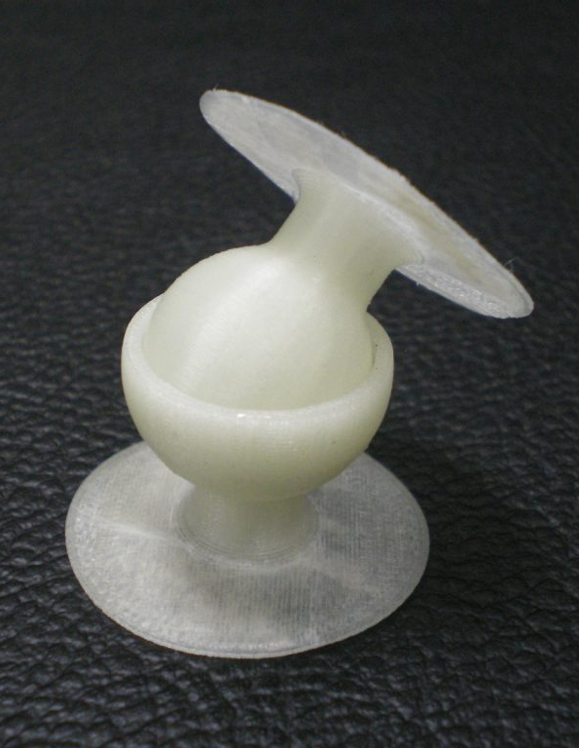
Hardware Specifics for Chosen Solution
Trigger Point Cane with a Single Stethoscope Head

Slide 33
Software Specifics for Chosen Solution
Language: Python 3.6
For simplicity and libraries
Algorithms
SVM for real time classification
CNN for recording classification
Training and Testing Data: ICBHI 2017 Respiratory Sound Database
Pipeline
Green: Real Time Classification Problem
Blue: Recording Classification Problem
SVM Model
Classification Results
Raw Data
Band Pass Filter 70-2000Hz
Feature Extraction
CNN Model
Classification Results
Notes:
Pipeline: Raw audio data is passed through a BP filter from 70-2000Hz for heart and muscle sound removal. Features such as Power spectrum density are extracted from filtered signal. For real time classification, an SVM model is applied. For classification of recordings, a CNN model is applied. The model returns a classification result for the physician or nurse to use.

Slide 34
References
1. Abdel-Hamid, Ossama, Li Deng, and Dong Yu. “Exploring Convolutional Neural Network Structures and Optimization Techniques for Speech Recognition,” n.d., 5.
2. Abdel-Hamid, Ossama, Abdel-rahman Mohamed, Hui Jiang, Li Deng, Gerald Penn, and Dong Yu. “Convolutional Neural Networks for Speech Recognition.” IEEE/ACM Transactions on Audio, Speech, and Language Processing 22, no. 10 (October 2014): 1533–45. https://doi.org/10.1109/TASLP.2014.2339736.
3. Aykanat, Murat, Özkan Kılıç, Bahar Kurt, and Sevgi Saryal. “Classification of Lung Sounds Using Convolutional Neural Networks.” EURASIP Journal on Image and Video Processing 2017, no. 1 (December 2017). https://doi.org/10.1186/s13640-017-0213-2.
4. Bahuleyan, Hareesh. “Music Genre Classification Using Machine Learning Techniques.” ArXiv:1804.01149 [Cs, Eess], April 3, 2018. http://arxiv.org/abs/1804.01149.
5. Boddapati, Venkatesh, Andrej Petef, Jim Rasmusson, and Lars Lundberg. “Classifying Environmental Sounds Using Image Recognition Networks.” Procedia Computer Science 112 (2017): 2048–56. https://doi.org/10.1016/j.procs.2017.08.250.
6. Bottou, Leon, and Chih-Jen Lin. “Support Vector Machine Solvers,” n.d., 27.
7. Casey, Michael. “General Sound Classification and Similarity in MPEG-7.” Organised Sound 6, no. 02 (August 2001). https://doi.org/10.1017/S1355771801002126.
8. Chu, Cheng-tao, Sang K Kim, Yi-an Lin, Yuanyuan Yu, Gary Bradski, Kunle Olukotun, and Andrew Y Ng. “Map-Reduce for Machine Learning on Multicore,” n.d., 8.
9. Chuan, Ching-Hua, Susan Vasana, and Asai Asaithambi. “Using Wavelets and Gaussian Mixture Models for Audio Classification.” In 2012 IEEE International Symposium on Multimedia, 421–26. Irvine, CA, USA: IEEE, 2012. https://doi.org/10.1109/ISM.2012.86.
10. Cowling, Michael, and Renate Sitte. “Comparison of Techniques for Environmental Sound Recognition.” Pattern Recognition Letters 24, no. 15 (November 2003): 2895–2907. https://doi.org/10.1016/S0167-8655(03)00147-8.
11. Deller, John R., Jr., John G. Proakis, and John H. Hansen. Discrete Time Processing of Speech Signals. 1st ed. Upper Saddle River, NJ, USA: Prentice Hall PTR, 1993.
12. Deng, Li, Ossama Abdel-Hamid, and Dong Yu. “A Deep Convolutional Neural Network Using Heterogeneous Pooling for Trading Acoustic Invariance with Phonetic Confusion.” In 2013 IEEE International Conference on Acoustics, Speech and Signal Processing, 6669–73. Vancouver, BC, Canada: IEEE, 2013. https://doi.org/10.1109/ICASSP.2013.6638952.
13. Dufaux, Alain, Laurent Besacier, Michael Ansorge, and Fausto Pellandini. “AUTOMATIC SOUND DETECTION AND RECOGNITION FOR NOISY ENVIRONMENT,” n.d., 4.
14. Fu, Zhouyu, Guojun Lu, Kai Ming Ting, and Dengsheng Zhang. “Learning Naive Bayes Classifiers for Music Classification and Retrieval.” In 2010 20th International Conference on Pattern Recognition, 4589–92. Istanbul, Turkey: IEEE, 2010. https://doi.org/10.1109/ICPR.2010.1121.
15. Guodong Guo, and S.Z. Li. “Content-Based Audio Classification and Retrieval by Support Vector Machines.” IEEE Transactions on Neural Networks 14, no. 1 (January 2003): 209–15. https://doi.org/10.1109/TNN.2002.806626.
16. Ikhsan, Imam, Ledya Novamizanti, and I Nyoman Apraz Ramatryana. “Automatic Musical Genre Classification of Audio Using Hidden Markov Model.” In 2014 2nd International Conference on Information and Communication Technology (ICoICT), 397–402. Bandung, Indonesia: IEEE, 2014. https://doi.org/10.1109/ICoICT.2014.6914095.
17. Islam, Md. Ariful, Irin Bandyopadhyaya, Parthasarathi Bhattacharyya, and Goutam Saha. “Multichannel Lung Sound Analysis for Asthma Detection.” Computer Methods and Programs in Biomedicine 159 (June 2018): 111–23. https://doi.org/10.1016/j.cmpb.2018.03.002.
18. Khreich, Wael, Eric Granger, Ali Miri, and Robert Sabourin. “On the Memory Complexity of the Forward–Backward Algorithm.” Pattern Recognition Letters 31, no. 2 (January 2010): 91–99. https://doi.org/10.1016/j.patrec.2009.09.023.
19. Lee, Honglak, Peter Pham, Yan Largman, and Andrew Y Ng. “Unsupervised Feature Learning for Audio Classification Using Convolutional Deep Belief Networks,” n.d., 9.
20. Louppe, Gilles. “Understanding Random Forests: From Theory to Practice.” ArXiv:1407.7502 [Stat], July 28, 2014. http://arxiv.org/abs/1407.7502.
21. Mak, M. W., Y. L. Lu, and K. W. Ku. “Improved Real Time Recurrent Learning Algorithms: A Review and Some New Approaches.” Neurocomputing 24 (1995): 13–36.
22. Pakhira, Malay K. “A Linear Time-Complexity k-Means Algorithm Using Cluster Shifting.” In 2014 International Conference on Computational Intelligence and Communication Networks, 1047–51. Bhopal, India: IEEE, 2014. https://doi.org/10.1109/CICN.2014.220.
23. Patel, Shyamal. “Machine Learning Using Heart Sound Classification Example Video,” November 13, 2018. https://www.mathworks.com/videos/machine-learning-using-heart-sound-classification-example-1515709249154.html.

Slide 35
References (cont.)
24. Piczak, Karol J. “Environmental Sound Classification with Convolutional Neural Networks.” In 2015 IEEE 25th International Workshop on Machine Learning for Signal Processing (MLSP), 1–6. Boston, MA, USA: IEEE, 2015. https://doi.org/10.1109/MLSP.2015.7324337.
25. Priya, T. Lakshmi, N.R. Raajan, N. Raju, P. Preethi, and S. Mathini. “Speech and Non-Speech Identification and Classification Using KNN Algorithm.” Procedia Engineering 38 (2012): 952–58. https://doi.org/10.1016/j.proeng.2012.06.120.
26. Rocha, B. M., D. Filos, L. Mendes, I. Vogiatzis, E. Perantoni, E. Kaimakamis, P. Natsiavas, et al. “Α Respiratory Sound Database for the Development of Automated Classification.” In Precision Medicine Powered by PHealth and Connected Health, edited by Nicos Maglaveras, Ioanna Chouvarda, and Paulo de Carvalho, 66:33–37. Singapore: Springer Singapore, 2018. https://doi.org/10.1007/978-981-10-7419-6_6.
27. Rojas, Raul. “The Complexity of Learning.” In Neural Networks A Systematic Introduction, 273–96. Springer-Verlag, 1996.
28. Sainath, Tara N., Abdel-rahman Mohamed, Brian Kingsbury, and Bhuvana Ramabhadran. “Deep Convolutional Neural Networks for LVCSR.” In 2013 IEEE International Conference on Acoustics, Speech and Signal Processing, 8614–18. Vancouver, BC, Canada: IEEE, 2013. https://doi.org/10.1109/ICASSP.2013.6639347.
29. Saki, Fatemeh, and Nasser Kehtarnavaz. “Background Noise Classification Using Random Forest Tree Classifier for Cochlear Implant Applications.” In 2014 IEEE International Conference on Acoustics, Speech and Signal Processing (ICASSP), 3591–95. Florence, Italy: IEEE, 2014. https://doi.org/10.1109/ICASSP.2014.6854270.
30. Su, Jiang, and Harry Zhang. “A Fast Decision Tree Learning Algorithm.” In Proceedings of the 21st National Conference on Artificial Intelligence - Volume 1, 500–505. AAAI’06. Boston, Massachusetts: AAAI Press, 2006. http://dl.acm.org/citation.cfm?id=1597538.1597619.
31. Verbeek, J. J., N. Vlassis, and B. Kröse. “Efficient Greedy Learning of Gaussian Mixture Models.” Neural Computation 15, no. 2 (February 2003): 469–85. https://doi.org/10.1162/089976603762553004.
32. Williams, Ronald J. “Gradient-Based Learning Algorithms for Recurrent Connectionist Networks,” n.d., 48.
33. O’Shea, Keiron, and Ryan Nash. “An Introduction to Convolutional Neural Networks.” ArXiv:1511.08458 [Cs], November 26, 2015. http://arxiv.org/abs/1511.08458.
34. Weisstein, Eric W. “Sigmoid Function.” Text. Accessed November 29, 2018. http://mathworld.wolfram.com/SigmoidFunction.html.
35. Guestrin, Carlos. “Unsupervised Learning or Clustering – K-Means Gaussian Mixture Models,” n.d., 67.
36. “Cluster Using Gaussian Mixture Models - MATLAB & Simulink.” Accessed November 29, 2018. https://www.mathworks.com/help/stats/clustering-using-gaussian-mixture-models.html.
37. “Create Gaussian Mixture Model - MATLAB.” Accessed November 29, 2018. https://www.mathworks.com/help/stats/gmdistribution.html.
38. “Gaussian Mixture Models - MATLAB & Simulink.” Accessed November 29, 2018. https://www.mathworks.com/help/stats/gaussian-mixture-models-1.html.
39. Beck, Christoph, and Julius Georgiou. “Wearable, Multimodal, Vitals Acquisition Unit for Intelligent Field Triage.” Healthcare Technology Letters 3, no. 3 (September 1, 2016): 189–96. https://doi.org/10.1049/htl.2016.0038.
40. Cholewczynski, Mark W, Mark A Krizik, and Homer Glen. “(76) Inventors: Lillana Grajales, Bloomingdale, IL,” n.d., 13.
41. Li, Shih-Hong, Bor-Shing Lin, Chen-Han Tsai, Cheng-Ta Yang, and Bor-Shyh Lin. “Design of Wearable Breathing Sound Monitoring System for Real-Time Wheeze Detection.” Sensors 17, no. 12 (January 17, 2017): 171. https://doi.org/10.3390/s17010171.
42. Natalia Migdal, Sam Felder, and Erlis Kllogjri. “Machine Learning Enabled Wearable Stethoscope,” January 29, 2018, 12.
43. Thomas E. Kaib, Shane S. Volpe, and John D. Macho. Method of Detecting Signal Clipping in a Wearable Ambulatory Medical Device. US 9204813 B2, n.d.
44. “AcuCurve Cane.” Accessed November 30, 2018. https://www.tptherapy.com/product/AcuCurve_Cane.
45. backofficeshow. TDL- Build Your Own Digital Stethoscope! Accessed November 30, 2018. https://www.youtube.com/watch?v=-3n26AjNn6c.
46. Grajales et. al. Wearable Auscultation System and Method. US 2006/0129067 A1, June 15, 2006.
47. “Trigger Point Cane - Google Search.” Accessed November 30, 2018. https://www.google.com/search?q=trigger+point+cane&safe=active&source=lnms&tbm=isch&sa=X&ved=0ahUKEwjkw-Xxw_zeAhUBNKwKHYsUBvsQ_AUIDygC#imgdii=d7EwRPykuAUCVM:&imgrc=mq6OHJgB9S54nM.
48. “Auscultation Points for Lung Sounds - Bing.” Accessed November 30, 2018. https://www.bing.com/images/search?view=detailV2&ccid=WAcAbdHw&id=128D38452722C9FBD1A0CCF0231487C4C18964AE&thid=OIP.WAcAbdHwIoV0_4qe_p4nPQHaEK&mediaurl=https%3a%2f%2fclassconnection.s3.amazonaws.com%2f246%2fflashcards%2f889246%2fjpg%2fper1326385417515.jpg&exph=460&expw=819&q=auscultation+points+for+lung+sounds&simid=608052854998500164&selectedIndex=7&ajaxhist=0.

Slide 36
Questions?

