Slide 1
Lung Auscultation System
Kevin Xie, Loren Shin, Hannah Aaron

Slide 2
Background
1

Slide 3
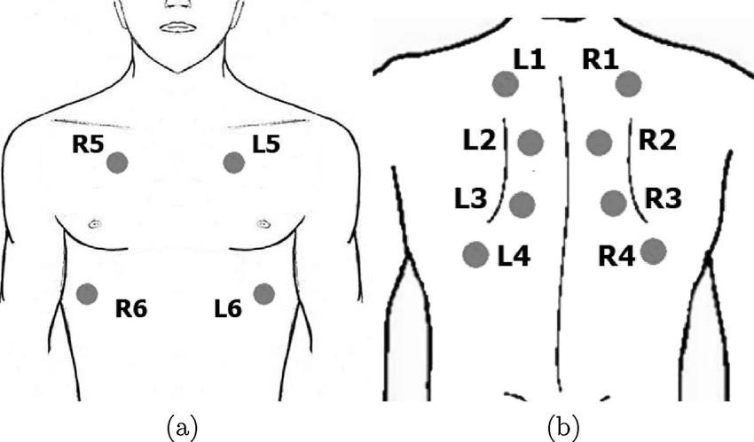
What is the Motivation?
Lung auscultation is a useful method for detecting and monitoring lung diseases
Our objective is to design a wearable, self-use device for capturing, recording, and transmitting lung sounds to physicians
Allows for regular supervision of patients – extremely advantageous in the field of telemedicine
2

Slide 4
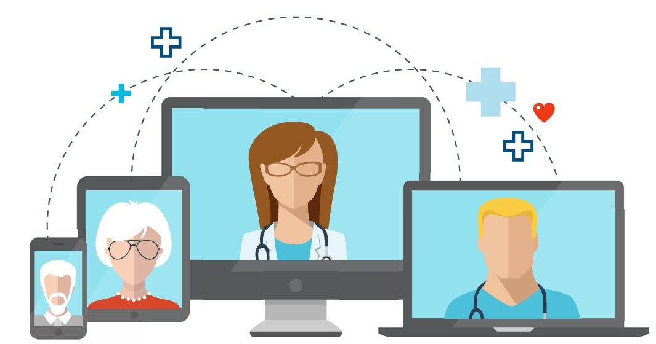
What is telemedicine?
Grown rapidly as a method of delivering healthcare
Increasingly popular in the last decade
Reduces hospital labor costs
Lowers physician turnover rates
Decreases time spent in ICUs or hospitals rather than at home
3

Slide 5
Our Client
Mercy Virtual and pulmonologist Dr. Wilman Ortega
Mercy Virtual Care Center is a leader in telemedicine
Remote hospitals
Remote ICUs
Home care management services
4

Slide 6
Problem Definition
5
Notes:
LACK OF AFFORDABLE AND PORTABLE INSTRUMENTAITON FOR remotely monitoring lung sounds for telemedice

Slide 7
Need and Project scope
There is a need to develop an affordable, digital, and wearable lung sound recording and classifying device for doctors and nurses to use so that they may better monitor the pulmonary activity of a greater proportion of patients.
By the end of April, we propose to have a working prototype of the device for capturing and classifying lung sounds along with the necessary software code and device design schematics. This prototype will need to be wearable, sensitive to sounds in a wide range of frequencies, and capable of filtering out noise and unnecessary sounds. It should be able to interface with a computer running software that classifies lung sounds as normal or abnormal.
6

Slide 8
Design specifications: Sound Recording platform
Attribute | Specification
Completion Date | End of April, 2019
Cost | Less than $300
Weight | Less than 2.5 lb
Estimated Total Size | 2 x 2 x 25 in
Computer Connection Interface | 3.5mm Audio Jack or USB Connector
Power Source | Powered using the connected computer
Duration worn by patient | Dependent on Patient Condition
7
Notes:
Here are our design specifications for the sound recording platform portion of our system

Slide 9
Design specification: computer system and software
Computer Attribute | Specification
CPU Speed for rapid processing/classification | Greater than 2.2 GHz
RAM Capacity to maintain signal information | Greater than 8 GB
Interface with Sound Recording Platform | 3.5mm Audio Jack or USB Connector
Python 3.6 Compatible OS | Windows 10 or Mac OS X
Software Attribute | Specification
Coding Language | Python 3.6
Heart/Muscle Sound Filtration | Band-pass filter at 70-2000Hz
Mains Filtration | 50/60 Hz Noise filter
Classification Domains | Abnormal and Normal
8
Notes:
And here are our design specifications for the computer and software side of the system

Slide 10
Existing solutions
9
Notes:
Next I will present some of the existing solutions that we have found

Slide 11
What are the Current solutions?
Current Digital Stethoscopes | Cost
Eko Core Attachment | $199.99
TytoCare TytoHome (includes Digital Stethoscope) | $299.00
Thinklabs One Digital Stethoscope | $474.98
AMD Interactive Stethoscope | N/A
Elegant Medical Electronic Stethoscope | N/A
10

Slide 12
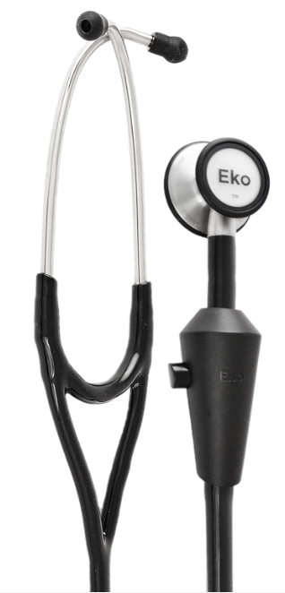
Eko Core attachment
Digital accessory that attaches to any normal stethoscope
Reduces unwanted noise and amplifies the sound
Digitally records and transmits the sound to a Bluetooth connected device
From Eko [13]
11
Notes:
It is a digital accessory for normal stethoscopes that can reduce noise and amplify sound. Using bluethooth, it can record and transmit sound to a mobile device so that physicians can listen to it remotely

Slide 13
Tytocare tytohome
Purely digital scope, only consisting of the head
Portable and ease-to-use for patients
Records data and sounds to be accessed remotely
From TytoCare [37]
12
Notes:
Purely digital scope that is designed for the consumer rather than the physician, that records the sounds to be accessed

Slide 14
Thinklabs one digital stethoscope
Purely digital scope, consisting only of stethoscope head
Compact in size and portable
Sounds heard through headphones and transmitted to a Bluetooth connected device
From Thinklabs [36]
13
Notes:
The TLO stethoscope only consists of the stethoscope head, which allows it to be compact and highly portable. … Additionally, it come with a built in noise-filtration system, allowing it to attain a very clear signal

Slide 15
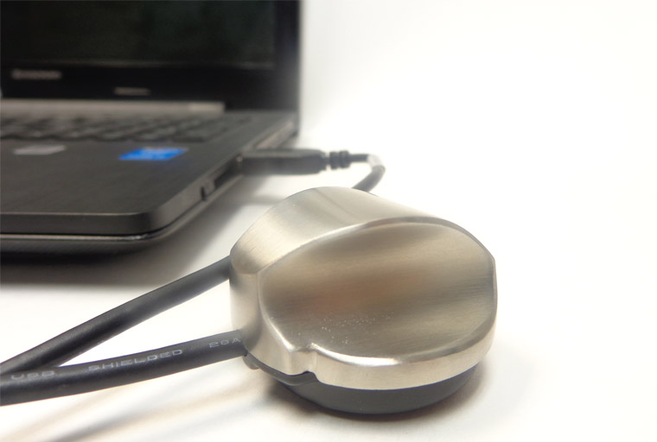
Amd interactive stethoscope
Completely digital stethoscope head that connects directly to a computer
Provides control over volume and frequency filters
Listen to the sounds through the computer
From AMD Global Telemedicine [20]
14
Notes:
The AMD interactive stethoscope is purely digital, connecting directly to the computer to power it, listen to lung sounds, and control the volume and frequency filters.

Slide 16
Elegant medical electronic stethoscope
Digital stethoscope head that transmits sound as an electrical signal representing acoustic vibrations
Minimizes ambient noise and has a high sensitivity to the desired sound signal
From Elegant Medical [17]
15
Notes:
The Elegant Medical Electronic Stethoscope uses an electrical signal to transmit the sound to the ear piece, giving more clarity and precision of the desired sound signal.

Slide 17
Comparison of existing solutions
 | Low Cost | Portable | Wireless/ Bluetooth | Record Digital Signal | Remote Access to Sound | Easy-to-Use for Patient | Amplify Sound | Frequency Filters | Wearable
Eko Core Attachment | x | x | x | x | x |  | x | x
TytoCare TytoHome | x | x | x | x | x | x | x | x
ThinkLabs One Digital Stethoscope |  | x | x | x | x |  | x | x
AMD Interactive Stethoscope |  |  |  | x |  |  | x | x
Elegant Medical Electronic Stethoscope |  | x |  |  |  |  | x | x
16

Slide 18
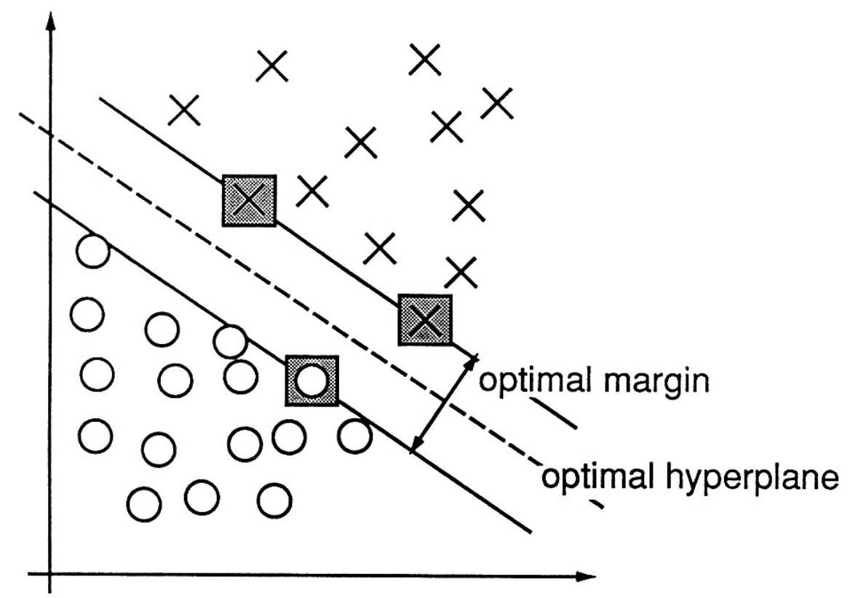
Software solutions
Traditional Algorithms
Support Vector Machine
Machine Learning Principles and Techniques
Feature extraction
Dimensionality reduction
From Cortes and Vapnik, 1995 ^{[7]}
17
Notes:
Audio classification has been a topic in the computer science community for decades. Numerous algorithms from machine learning have been adapted to process sounds. For example, SVMs can classify environemtnal sounds with an accuracy of up to 90%

Slide 19
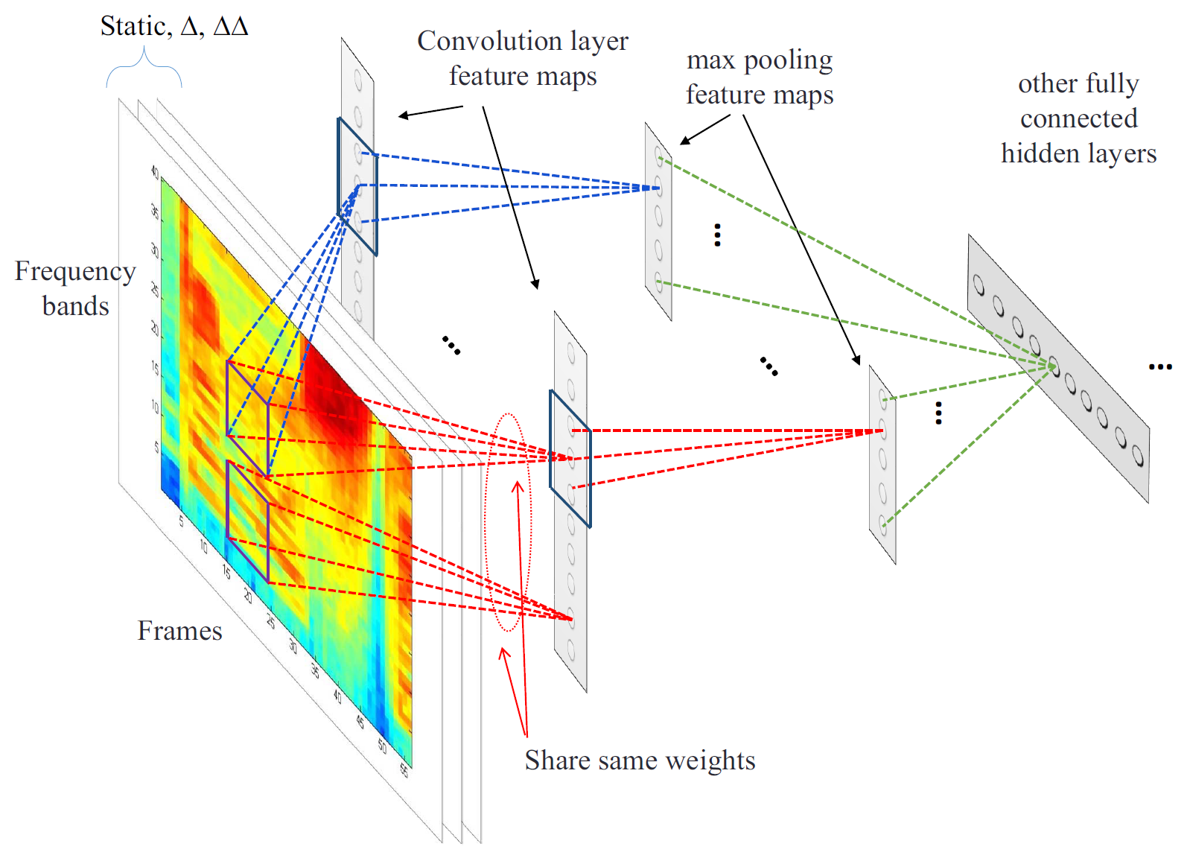
Neural Networks
Layers of interconnected nodes (neurons) where information is transmitted and weights applied
High computational cost precluded effective use
Convolutional Neural Network
Convolution Layer
Pooling Layer
Standard network layers
From Abdel-Hamid, et al. 2013 [2]
18
Notes:
Neural networks have also been used for audio classification. In a neural network, you <bullet one>. This allows them to find complex patterns from the data. However, these networks have extremely high computational cost, and in the past, most systems could only hand a handful of neurons spread across one or two layers. As a result, these networks were highly inaccurate and not effective. They often couldn't achieve accuracy rates over 50%
Nonetheless, modern advancements in computational ability and mathematical formulae have revived the Neural Network, allowing for hundreds or even thousands of neurons across dozens of layers, creating the field of "deep learning". One popular network that has been applied to audio classification is the CNN, which adds additional convolution and pooling layers over the standard network layers. The convolution layer...

Slide 20
Design and development
19

Slide 21
Design Schedule
20
Notes:
Here is our gantt chart. We plan to have our concept brainstormed, selected and analyzed before the middle of November, after which we present our decisions at the progress report. Then, we plan to begin construction and programming at the beginning of December through early February. After testing the protype, we will present our resultsr at the V&V presentation. Afterwards, we plan on updating, testing and analyzing the new prototype and presenting our results in the final report and poster presentation, which takes us to the end of april and beginning of may.

Slide 22
Team responsibilities
 | Loren | Hannah | Kevin
Research | x | x | x
Mentor Outreach |  |  | x
Website | x | x
Brainstorming | x | x | x
CAD Modelling |  | x
Software Coding | x |  | x
Prototyping | x | x | x
Prototype testing | x | x | x
Preliminary Presentation |  |  | x
Progress Presentation | x
V&V Presentation |  | x
21
Notes:
Finally, we have the distribution of our responsibilities.

Slide 23
Questions?
22

Slide 24
References
Abdel-Hamid, O., et al. “Convolutional Neural Networks for Speech Recognition.” IEEE/ACM Transactions on Audio, Speech, and Language Processing, vol. 22, no. 10, Oct. 2014, pp. 1533–45. IEEE Xplore, doi:10.1109/TASLP.2014.2339736.
Abdel-Hamid, Ossama, et al. “Exploring Convolutional Neural Network Structures and Optimization Techniques for Speech Recognition.” INTERSPEECH, 2013.
Atomicdust. “About.” Mercy Virtual, http://www.mercyvirtual.net/about/. Accessed 5 Oct. 2018.
---. “Is Telemedicine the Future of Care?” Mercy Virtual, 12 Feb. 2018, http://www.mercyvirtual.net/telemedicine-future-care/.
Baum, Stephanie. “4 Digital Stethoscope Businesses That Want to Transform Healthcare.” MedCity News, 25 Jan. 2018, https://medcitynews.com/2018/01/4-digital-stethoscope-businesses-want-transform-healthcare/.
Casey, Michael. “General Sound Classification and Similarity in MPEG-7.” Organised Sound, vol. 6, no. 02, Aug. 2001. Crossref, doi:10.1017/S1355771801002126.
Cortes, Corinna, and Vladimir Vapnik. “Support-Vector Networks.” Machine Learning, vol. 20, no. 3, Sept. 1995, pp. 273–97. Crossref, doi:10.1007/BF00994018.
Cowling, Michael, and Renate Sitte. “Comparison of Techniques for Environmental Sound Recognition.” Pattern Recognition Letters, vol. 24, no. 15, Nov. 2003, pp. 2895–907. ScienceDirect, doi:10.1016/S0167-8655(03)00147-8.
CS231n Convolutional Neural Networks for Visual Recognition. http://cs231n.github.io/convolutional-networks/. Accessed 5 Oct. 2018.
Deng, Li, et al. “A Deep Convolutional Neural Network Using Heterogeneous Pooling for Trading Acoustic Invariance with Phonetic Confusion.” 2013 IEEE International Conference on Acoustics, Speech and Signal Processing, IEEE, 2013, pp. 6669–73. Crossref, doi:10.1109/ICASSP.2013.6638952.
Dieleman, Sander, et al. “Audio-Based Music Classification with a Pretrained Convolutional Network.” Proceedings of the 12th International Society for Music Information Retrieval Conference : Proc. ISMIR 2011, University of Miami, 2011, pp. 669–74. biblio.ugent.be, http://hdl.handle.net/1854/LU-1989534.
Dufaux, A., et al. “Automatic Sound Detection and Recognition for Noisy Environment.” 2000 10th European Signal Processing Conference, 2000, pp. 1–4.
Eko | CORE Electronic Stethoscope. https://ekodevices.com/core/. Accessed 5 Oct. 2018.
Emmanouilidou, Dimitra, and Mounya Elhilali. Lung Sound Denoising Stethoscope, Algorithm, and Related Methods. US9848848B2, 26 Dec. 2017, https://patents.google.com/patent/US9848848B2/en?q=thinklab&q=bluetooth&q=stethoscope&oq=thinklab+bluetooth+stethoscope.
“Explained: Neural Networks.” MIT News, http://news.mit.edu/2017/explained-neural-networks-deep-learning-0414. Accessed 5 Oct. 2018.
Guodong Guo, and S. Z. Li. “Content-Based Audio Classification and Retrieval by Support Vector Machines.” IEEE Transactions on Neural Networks, vol. 14, no. 1, Jan. 2003, pp. 209–15. Crossref, doi:10.1109/TNN.2002.806626.
Habboushe, Joseph, et al. Electronic Stethoscope. US20140153730A1, 5 June 2014, https://patents.google.com/patent/US20140153730A1/en?q=thinklab&q=bluetooth&q=stethoscope&oq=thinklab+bluetooth+stethoscope.
Hof, Robert D. “Is Artificial Intelligence Finally Coming into Its Own?” MIT Technology Review, https://www.technologyreview.com/s/513696/deep-learning/. Accessed 5 Oct. 2018.
Hung, K., et al. “Multifunction Stethoscope for Telemedicine.” 2004 2nd IEEE/EMBS International Summer School on Medical Devices and Biosensors, 2004, pp. 87–89. IEEE Xplore, doi:10.1109/ISSMD.2004.1689568.
Interactive-Stethoscope. https://www.amdtelemedicine.com/telemedicine-equipment/interactive-stethoscope.html. Accessed 5 Oct. 2018.
Islam, Md Ariful, et al. “Multichannel Lung Sound Analysis for Asthma Detection.” Computer Methods and Programs in Biomedicine, vol. 159, June 2018, pp. 111–23. PubMed, doi:10.1016/j.cmpb.2018.03.002.
Lee, Honglak, et al. “Unsupervised Feature Learning for Audio Classification Using Convolutional Deep Belief Networks.” NIPS, 2009.
“Lung Sounds | Over 50 Lessons, Reference Guides and Quiz.” Easy Auscultation, https://www.easyauscultation.com/lung-sounds. Accessed 5 Oct. 2018.
Moore, Mark. Wireless Medical Stethoscope. US6533736B1, 18 Mar. 2003, https://patents.google.com/patent/US6533736B1/en?q=wireless&q=stethoscope&oq=wireless+stethoscope.
O’Shea, Keiron, and Ryan Nash. “An Introduction to Convolutional Neural Networks.” ArXiv:1511.08458 [Cs], Nov. 2015. arXiv.org, http://arxiv.org/abs/1511.08458.
Park, Paul. Stethoscope Adapter System for a Headset Microphone. US9770224B2, 26 Sept. 2017, https://patents.google.com/patent/US9770224B2/en?q=eko&q=stethoscope&oq=eko+stethoscope.
Piczak, Karol J. “Environmental Sound Classification with Convolutional Neural Networks.” 2015 IEEE 25th International Workshop on Machine Learning for Signal Processing (MLSP), IEEE, 2015, pp. 1–6. Crossref, doi:10.1109/MLSP.2015.7324337.
Polat, Hüseyin, and İnan Güler. “A Simple Computer-Based Measurement and Analysis System of Pulmonary Auscultation Sounds.” Journal of Medical Systems, vol. 28, no. 6, Dec. 2004, pp. 665–72. Springer Link, doi:10.1023/B:JOMS.0000044968.45013.ce.
Sainath, Tara N., et al. “Deep Convolutional Neural Networks for LVCSR.” 2013 IEEE International Conference on Acoustics, Speech and Signal Processing, IEEE, 2013, pp. 8614–18. Crossref, doi:10.1109/ICASSP.2013.6639347.
Sun, X., et al. “Real Time Analysis of Lung Sounds.” Technology and Health Care: Official Journal of the European Society for Engineering and Medicine, vol. 6, no. 1, June 1998, pp. 3–10.
“Thinklabs Lung Sound Library.” Thinklabs ONE - Digital Stethoscope, https://www.thinklabs.com/copy-of-lung-sounds. Accessed 5 Oct. 2018.
Weisstein, Eric W. Convolution. http://mathworld.wolfram.com/Convolution.html. Accessed 5 Oct. 2018.
梁庆真, and 刘传银. 在智能平台上实现心音与肺音分类的方法. CN107704885A, 16 Feb. 2018, https://patents.google.com/patent/CN107704885A/en?oq=CN107704885A.
焦超, et al. 种基于卷积神经网络的肺音分类方法、系统及用途. CN107818366A, 20 Mar. 2018, https://patents.google.com/patent/CN107818366A/en?oq=CN107818366A.
罗狄锋, et al. 心肺音信号分类方法、检测方法、装置、介质和计算机设备. CN107945817A, 20 Apr. 2018, https://patents.google.com/patent/CN107945817A/en?oq=CN107945817A.
“Thinklabs One Digital Stethoscope.” Thinklabs ONE - Digital Stethoscope, https://www.thinklabs.com/one-digital-stethoscope. Accessed 7 Oct. 2018.
TytoHome. https://www.tytocare.com/tytohome/. Accessed 5 Oct. 2018.
23

